Slide 1
Introduction to SQL

Slide 2
Introduction to SQL
A standard language used in most DBMS.
Both as a DDL and DML language.
  DDL (Data Definition Language): define the schema of the database.
  DML (Data Manipulation Language): provides commands to manipulate the database (query, insert, update, delete).

Slide 3
SQL Continued
Based on relational algebra, but not entirely identical.
  Relations ⇔ Tables
  Tuples ⇔ Rows
  Attributes ⇔ Columns

Slide 4
Basic DDL Commands in SQL
CREATE: to define new tables (to define relation schemas)
DROP: to delete table definitions (to delete relation schemas)
ALTER: to change the definitions of existing tables (to change relation schema)
Other features as DDL
  Specify referential integrity constraints (FKs)
  Specify user-defined attributes constraints

Slide 5
Basic DML Commands in SQL
INSERT: to add new rows to table
UPDATE: to change the “state” (the value) of rows.
DELETE: to remove rows
SELECT: a query command that uses relation algebra like expressions
Various options available to handle the enforcement/violation of integrity constraints

Slide 6
Platforms of This Course
Platform 1: MySQL
  Open source, free software
  Available on Windows and Linux.
  Easily installed on your own PC.
Platform 2: Oracle 10g Enterprise Edition
  Available through IT&E labs
  Proprietary, popular DBMS
- Please see http://labs.ite.gmu.edu/reference/faq_oracle.htm for details.

Slide 7
MySQL
Open source and free
Generally not as powerful as Oracle
Still, it is an industrial strength package.
  Users include Amazon, NASA, Google, Yahoo …
A commercial edition is also available (MySQL Enterprise) --- You are paying for the services.

Slide 8
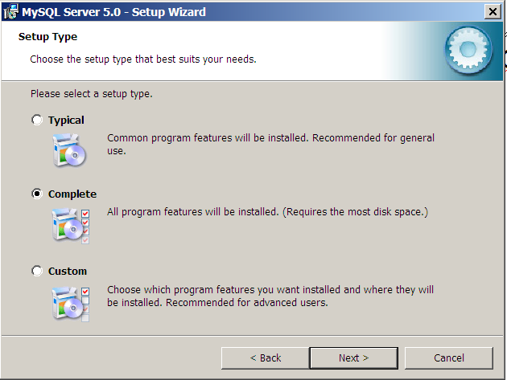
Installation on Windows
Download the Essential Version of MySQL 5.0 from mysql.com
Click on the .exe file to start installation.
In Setup Type, Choose “Complete”

Slide 9
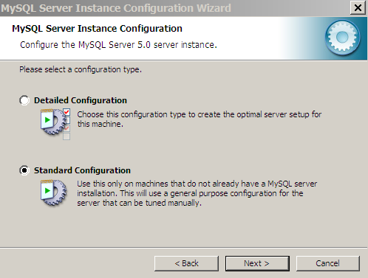
Use Standard Configuration

Slide 10
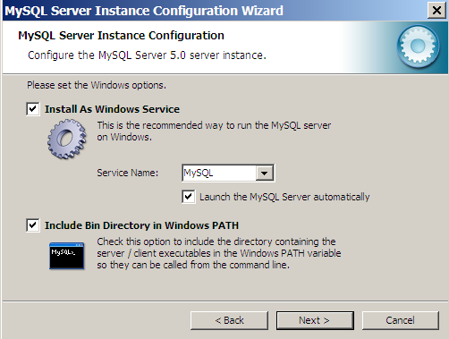
Install As Windows Service

Slide 11
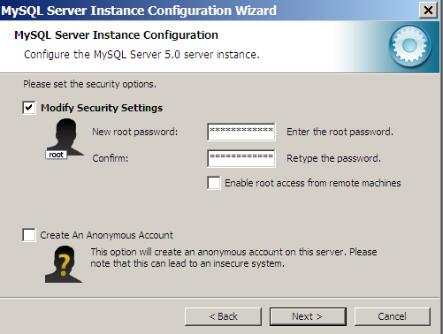
Set Root Password

Slide 12
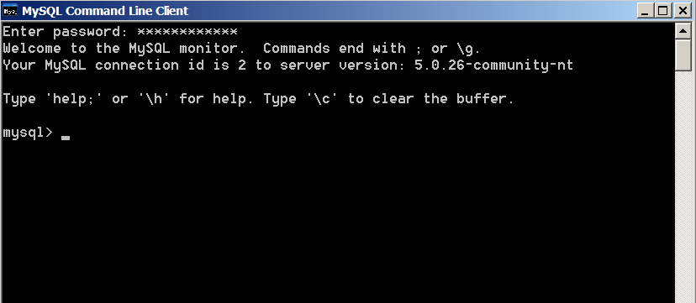
Launch MySQL
Use the Start menu to launch the
“MySQL Command Line Client”
Enter the root password

Slide 13

The COMPANY Database

Slide 14
Create the COMPANY Database
To create
create datatbase COMPANY;
To use (or switch to) the database
use COMPANY;
Subsequent commands will operate on the COMPANY database by default.

Slide 15
CREATE TABLE
CREATE TABLE DEPARTMENT (
  Dname VARCHAR(10) NOT NULL,
  Dnumber INTEGER Default 0,
  Mgr_ssn CHAR(9),
  Mgr_Sartdate CHAR(9),
  PRIMARY KEY (Dnumber),
  UNIQUE (Dname),
  FOREIGN KEY (Mgr_ssn)
  REFERENCES EMPLOYEE (Ssn));
The “UNIQUE” clause specifies secondary keys.
EMPLOYE)has to be created first for the FK Mgr_ssn to refer to it.

Slide 16
Additional Data Types
DATE:
  Made up of year-month-day in the format yyyy-mm-dd
TIME:
  Made up of hour:minute:second in the format hh:mm:ss
TIMESTAMP:
  Has both DATE and TIME components
Decimal (i,j):
  i: total number of digits
  j: the number of digits after the decimal point
Others: Boolean, Float, Double Precision

Slide 17
Adding the Dno FK to EMPLOYEE
If “create table EMPLOYEE” is issued first, we cannot specify Dno as a FK in that create command.
An ALTER command must be used to change the schema of EMPLOYEE, after the “create table DEPARTMENT,” to add a FK.
alter table EMPLOYEE
add constraint
foreign key (Dno)
references DEPARTMENT (Dnumber);

Slide 18
The Check Clause
Used to specify user-defined constraints
Assume that dept. numbers are from 0 to 99.
create table DEPARTMENT (
  …
  Dnumber INTEGER Default 0
  check (Dnumber>=0 AND Dumber<=99),
  …);
“Check” can also be a clause of the entire table.
create table DEPARTMENT (
  …
  Dept_create_date date,
  Mgr_start_date date,
  check (Dept_create_date <= Mgr_start_date)
  );

Slide 19
Add Columns to Existing Tables
To add spouse SSN (S_ssn) to EMPLOYEE
alter table EMPLOYEE add column S_ssn char(9);
  The new attribute will have NULLs in all the tuples of the relation right after the command is executed
Alternatively, we can set a default value.
alter table EMPLOYEE add column S_ssn char(9)
  default “000000000”;

Slide 20
Delete Columns from Existing Tables
To delete column S_ssn
alter table EMPLOYEE drop column S_ssn;
Reminder: changing relation schemas typically indicates ill-executed design phase of the database.

Slide 21
Referential Integrity Options
Causes of referential integrity violation for a foreign key FK (consider the Mgr_ssn of DEPARTMENT).
  On Delete: when deleting the foreign tuple
    What to do when deleting the manager tuple in EMPLOYEE ?
  On Update: when updating the foreign tuple
    What to do when updating/changing the SSN of the manager tuple in EMPLOYEE is changed ?
Actions when the above two causes occur.
  Set Null: the Mgr_ssn is set to null.
  Set Default: the Mgr_ssn is set to the default value.
  Cascade: the Mgr_ssn is updated accordingly
    If the manager is deleted, the department is also deleted.

Slide 22
The Mgr_ssn Example
CREATE TABLE DEPARTMENT (
  …
  Mgr_ssn CHAR(9),
  …
  FOREIGN KEY (Mgr_ssn)
  REFERENCES EMPLOYEE (Ssn)
  ON DELETE ???
  ON UPDATE ???
  );

Slide 23
Another Example
Create table EMP(
…
ESSN CHAR(9),
DNO INTEGER DEFAULT 1,
SUPERSSN CHAR(9),
PRIMARY KEY (ESSN),
FOREIGN KEY (DNO) REFERENCES DEPT
ON DELETE SET DEFAULT
  ON UPDATE CASCADE,
FOREIGN KEY (SUPERSSN) REFERENCES EMP ON DELETE SET NULL
  ON UPDATE CASCADE);

Slide 24
Another Example
Create table EMP(
…
ESSN CHAR(9),
DNO INTEGER DEFAULT 1,
SUPERSSN CHAR(9),
PRIMARY KEY (ESSN),
FOREIGN KEY (DNO) REFERENCES DEPT
ON DELETE SET DEFAULT
  ON UPDATE CASCADE,
FOREIGN KEY (SUPERSSN) REFERENCES EMP ON DELETE SET NULL
  ON UPDATE CASCADE);

Slide 25
Miscellaneous Commands
show databases;
  Show all the databases on the server
show tables;
  Show all the tables of the present database
show columns from table EMPLOYEE;
drop table t_name;
  Delete the entire table t_name
drop database db_name;
  Delete the entire database db_name
load data infile f_name into table t_name;
  To be discussed with the next homework.

